Slide 1

The Convergence of AI and Blockchain: Transforming Digital Innovation
This presentation explores how artificial intelligence and blockchain technologies are converging to create powerful new solutions across industries. We'll examine real-world applications, benefits, challenges, and future directions of this technological synergy.
by Michael Garcia, Hashim SAYED HOOSINI, Miguel Mora

Slide 2
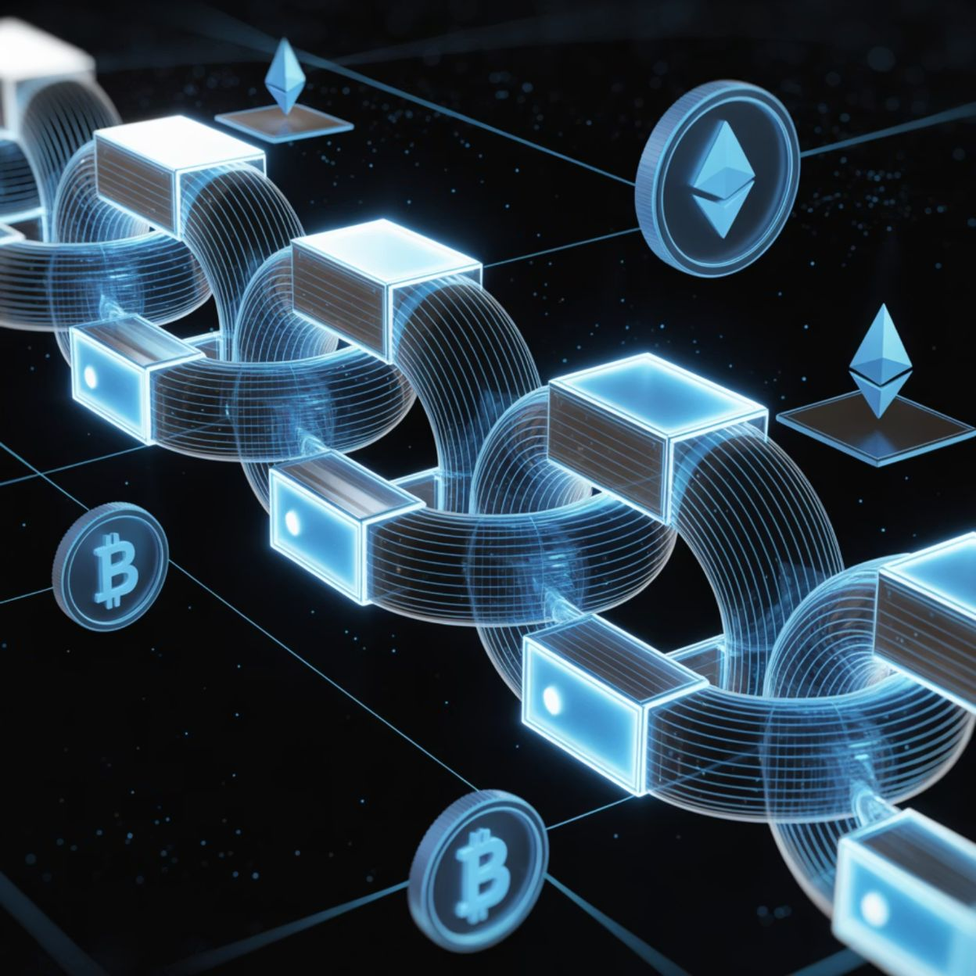
Understanding Blockchain Technology
What is Blockchain?
A decentralized, distributed ledger technology that records transactions across multiple computers. Each block contains a timestamp and link to the previous block, creating an immutable chain.
Key Features
Decentralization: No central authority
Transparency: Public verification
Immutability: Records cannot be altered
Security: Cryptographic protection

Slide 3




Domain Overview & Importance
Finance
Healthcare
Supply Chain
Transforming transactions, fraud detection, and automated compliance. The financial sector was valued at $22.5 trillion globally in 2021.
Revolutionizing secure patient data management, medical research, and drug discovery in a $8.3 trillion global industry.
Enhancing transparency, traceability, and efficiency across global supply networks worth over $15 trillion annually.
Government
Improving voting systems, identity verification, and public records management affects billions of citizens worldwide.

Slide 4

AI Use Case Motivation
Real-World Problem: Supply Chain Inefficiencies
Global supply chains suffer from:
Lack of transparency (31% of businesses cite this as their biggest challenge)
Counterfeit products ($1.8 trillion market globally)
Slow, paper-based processes (adding 5-15% to operational costs)
Difficulty tracing product origins during recalls
AI and blockchain together create end-to-end visibility, automated verification, and real-time tracking capabilities.

Slide 5
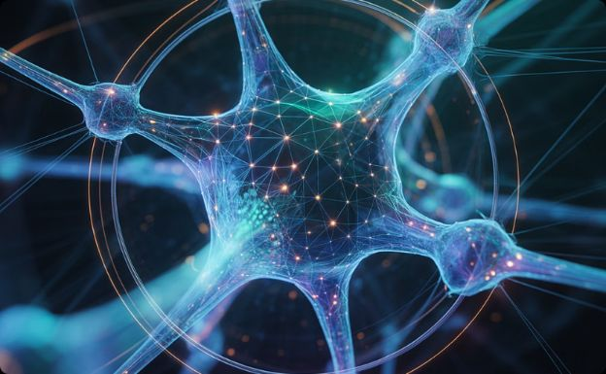
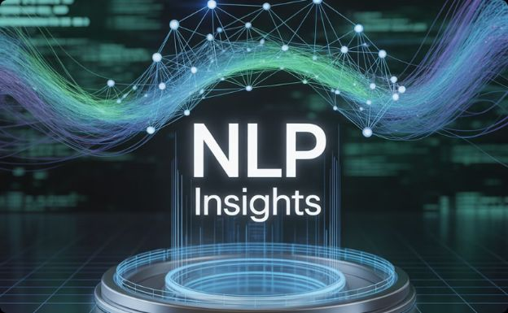
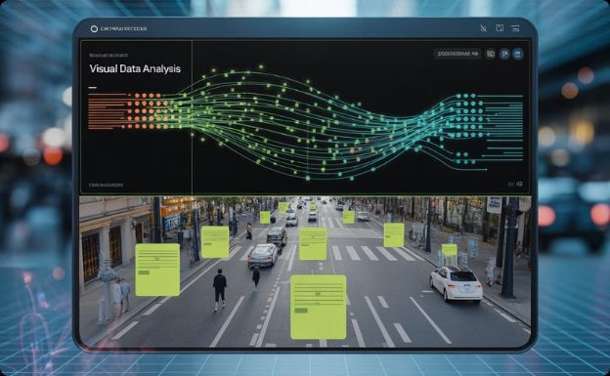
AI Techniques Used in Blockchain Integration
Machine Learning
Algorithms that improve through experience are used for pattern recognition in transaction data and anomaly detection
for security.
Natural Language Processing
Enables smart contracts to understand and process human language, automating contract execution
based on real-world inputs.
Computer Vision
Visual data analysis for supply chain verification, combined with blockchain to create immutable visual records of products.

Slide 6
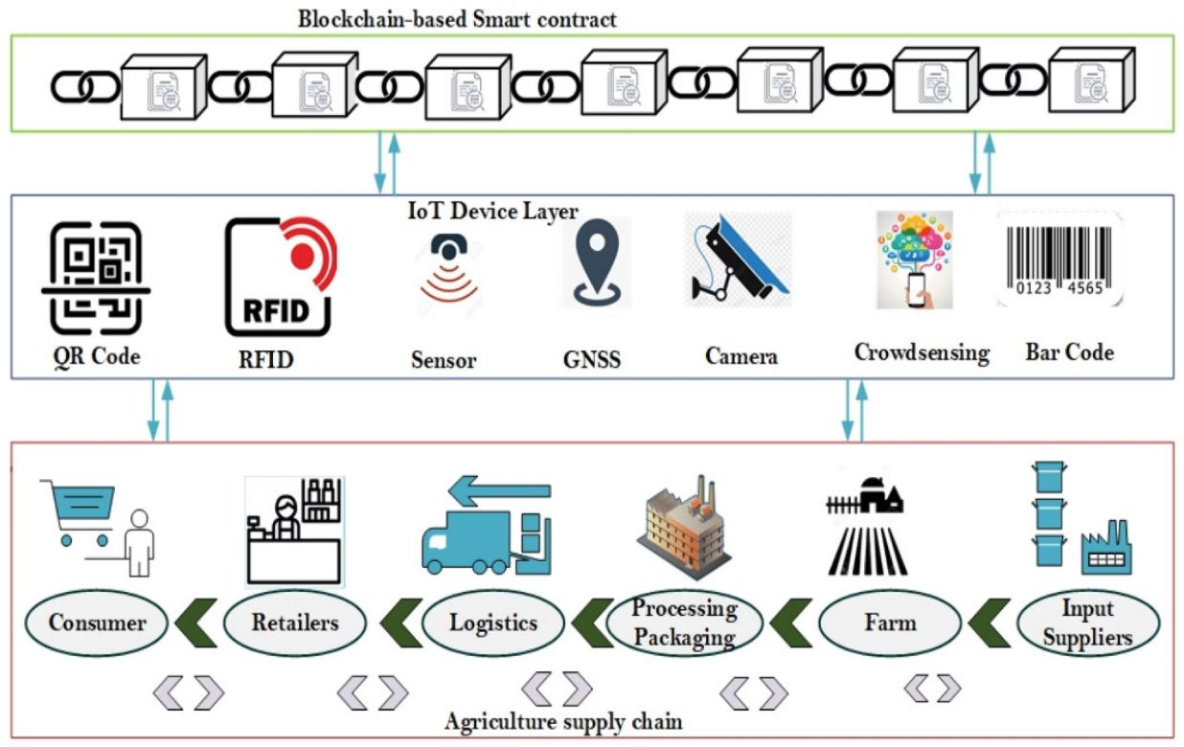
Key Applications: Case Study 1
IBM Food Trust
A blockchain-powered platform enhanced with AI capabilities to transform food supply chain traceability.
Implementation:
Tracks products from farm to consumer
AI analyzes supply chain patterns to predict issues
Machine learning identifies optimal routing and inventory management
Results:
99.9% reduction in time to trace food origins (from 7 days to 2.2 seconds)
30% decrease in food waste across the supply chain
Walmart reduced food safety incident response time by 96%

Slide 7

Impact & Benefits
$1.76T
40%
99.99%
76%
Projected Global Value
Operational Efficiency
Security Enhancement
Trust Increase
Consumer trust improvement when products use verified AI-blockchain tracking (Deloitte survey)
Estimated economic value added by AI-blockchain integration by 2030 (PwC analysis)
Average improvement in business process efficiency when implementing both technologies
Reduction in successful fraud attempts when AI-powered security monitors blockchain transactions

Slide 8

Challenges & Risks
1
Technical Challenges
Blockchain's energy consumption and scalability issues (Bitcoin alone consumes more electricity than Argentina). AI integration adds computational complexity, potentially slowing transaction speeds by 15-40%.
2
Privacy Concerns
Balancing blockchain's transparency with data privacy requirements like GDPR. AI analysis may extract sensitive patterns from supposedly anonymous blockchain data, creating potential for re-identification attacks.
3
Regulatory Uncertainty
Evolving global regulations for both AI and blockchain create compliance challenges. Only 28% of countries have comprehensive frameworks addressing both technologies together.
4
Algorithmic Bias
AI systems may perpetuate biases when analyzing blockchain data, potentially creating discriminatory outcomes in financial services, supply chain decisions, and resource allocation.

Slide 9
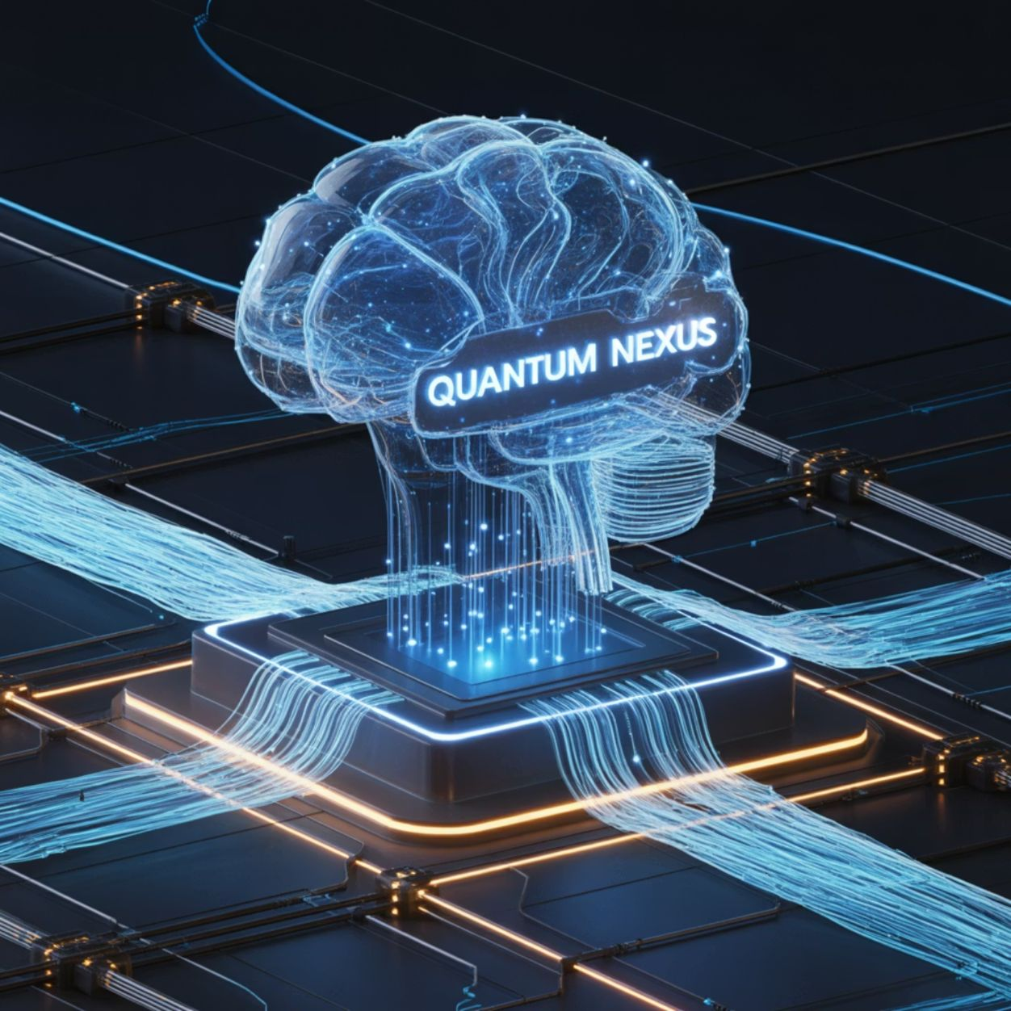



Future Directions
Emerging Trends in AI-Blockchain Integration
Federated Learning on Blockchain
Training AI models across decentralized data sources while maintaining privacy and data sovereignty
Autonomous Economic Agents
Self-executing AI entities that operate on blockchain networks to perform tasks, manage assets, and make decisions
Zero-Knowledge AI
Cryptographic techniques allowing AI to verify information without seeing sensitive data, enhancing privacy

Slide 10

Interactive Slide

Slide 11
Conclusion
Key Takeaways
AI and blockchain together create solutions greater than the sum of their parts
Real-world applications are delivering measurable benefits across industries
Technical and regulatory challenges remain but are being addressed
Future developments will continue to expand capabilities and use cases

Slide 12
References:
IBM Research (2023). "Food Trust: A Blockchain-based Food Ecosystem"
Deloitte (2023). "Blockchain and AI Integration Survey"
World Economic Forum (2022). "Reshaping Supply Chains with Technology"
PwC (2023). "Global AI and Blockchain Economic Impact Analysis"
MediLedger Project (2023). "Annual Impact Report"

